Slide 1
Smart Gardener
IoT Project Report
Yanwu ZHU , Yaoli Mi ,Ying Li

Slide 2
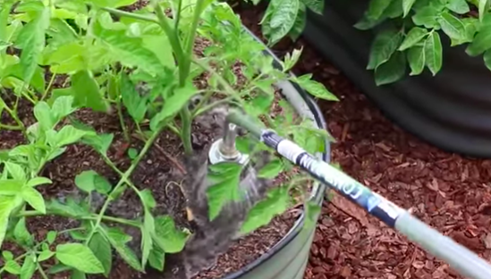
Description
·Detection
Sunlight、Moisture ...
·Watering
Automatically/manually
·Remote Control
Index display、Watering Switch..

Slide 3
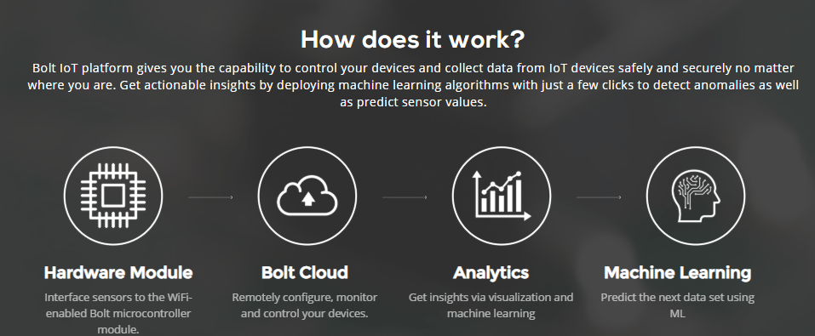
State-of-the-arts

Slide 4
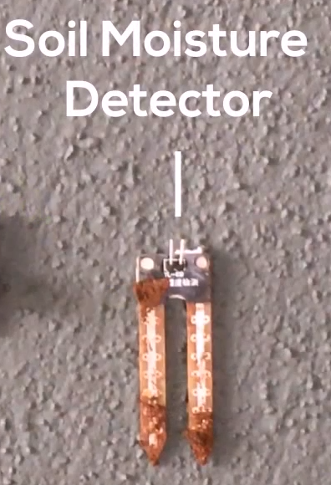
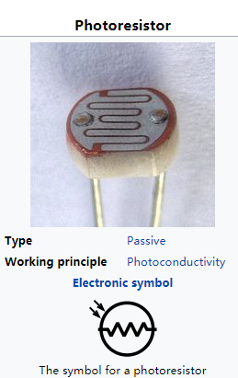
State-of-the-arts
·Resistance of the soil
·Calculate the moisture index
·High accuracy
·light to an electrical current
·temperature sensitive

Slide 5
Norms & Regulations
Privacy protocol
Norms on different detectors
Safety requirement on operating circuit

Slide 6
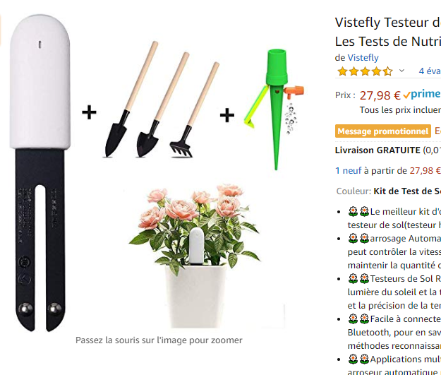
Advantages
Drawbacks of current apps /smart device:
Small Volume
2. No Smart App
3. No Integrated Functions
4. Relatively Expensive
With all those flaws exposed. Our ideal design is rather competitive in nowadays IoT gear market.

Slide 7
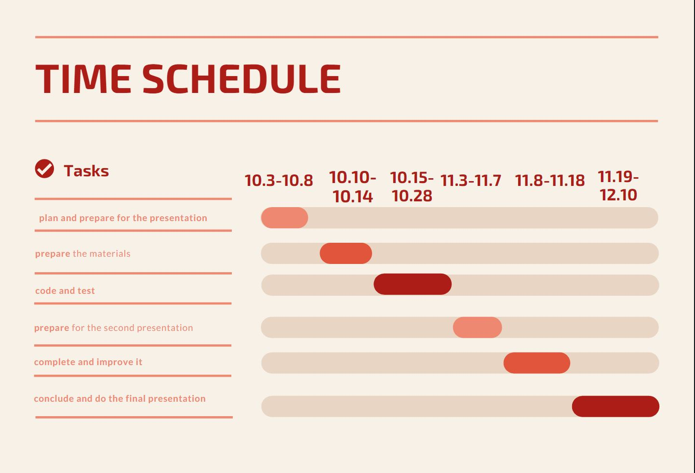

Slide 8
Thanks for attention

